Slide 1
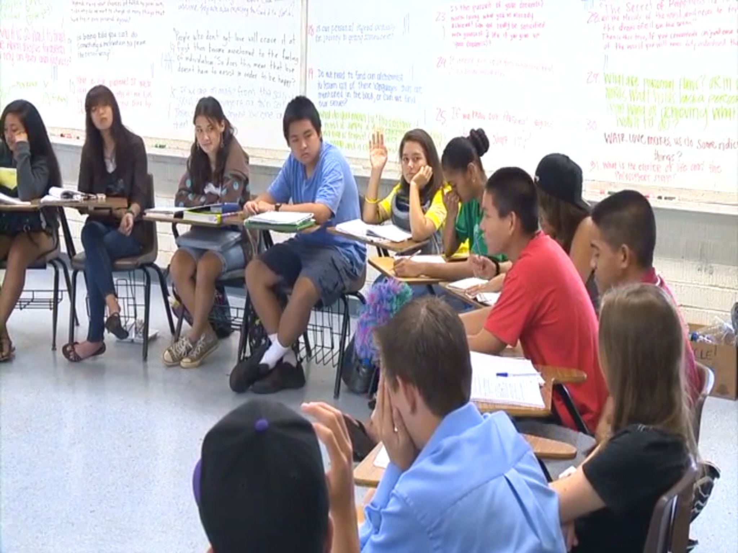
Cultivating and Nurturing Collaborative Civic Spaces: The philosophy for children Hawai‘i Approach to Deliberative Pedagogy
Dr. Amber Strong Makaiau
University of Hawai‘i Uehiro Academy for Philosophy & Ethics in Education

Slide 2
VISION: Education for the purpose of creating intellectually responsible communities
MISSION: We are dedicated to preparing, supporting and sustaining, educators, researchers, and students who engage or are interested in engaging in philosophy for children Hawai‘i worldwide

Slide 3
philosophy for children Hawai‘i
philosophy for children Hawai‘i (p4cHI) is an approach to teaching and learning that is defined by a conceptual framework and an accompanying set of activities

Slide 4
My Connection – Using p4cHI to Cultivate Collaborative Civic Spaces in Social Studies

Slide 5
Presentation/Workshop Outline
p4cHI: Theory, Practices, and Aims
The p4cHI Approach to Deliberative Pedagogy: Making the C3 Instructional Shift - Cultivating and Nurturing Collaborative Civic Spaces
HIDOE Philosophical Inquiry Course: One Example of How p4cHI is Being Used to Cultivate & Nurture Collaborative Civic Spaces
Experiencing p4cHI: Cultivating & Nurturing Collaborative Civic Spaces with Intellectual Safety, Community Ball, and Plain Vanilla

Slide 6
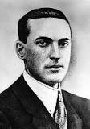
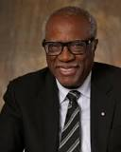
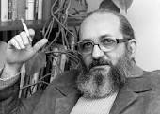
p4cHI Conceptual Framework The Four Pillars of p4cHI
Community Inquiry Philosophy Reflection

Slide 7
What do we mean by philosophy?
Big P & little P

Slide 8
What are the implications of philosophy as an activity?
philosophy becomes a way for students and teachers, of any age group, to engage with “content” in a variety of learning contexts

Slide 9
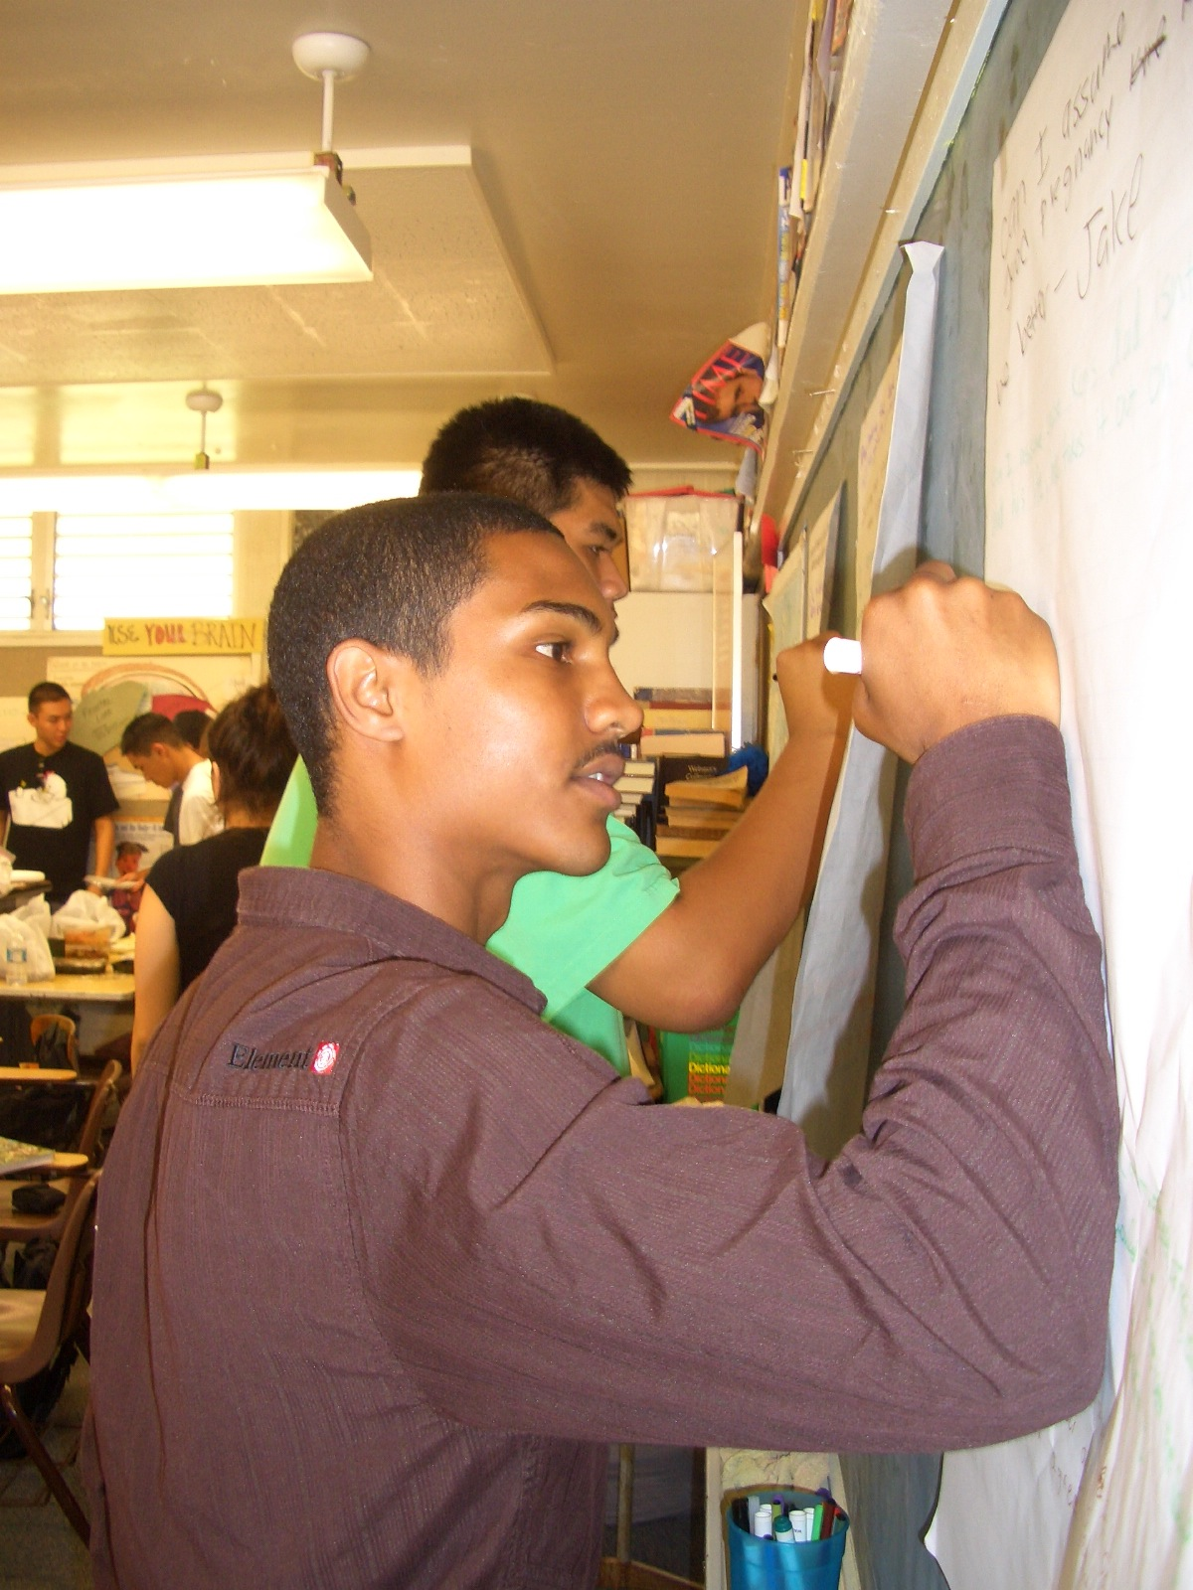
p4cHI Activities
Intellectual Safety
Community Ball
Good Thinker’s Tool Kit
Plain Vanilla Deliberative Inquiries
Magic Words
Evaluation of the Community of Inquiry

Slide 10
Six Teacher Commitments:
Live an examined life
Approach education as a shared activity between teacher and student
See “content” as learner/teacher beliefs + learner/teacher experiences + subject matter
View philosophy as “the general theory of education”
Make philosophy a living classroom practice
Challenge contemporary measures of assessment

Slide 11
Outcomes/Aims of the p4cHI Approach to Education
Good Judgment
Responsible & Ethical Community Member
Philosophical Reflection
Empathy
Joyous Learning
Transformative Experience

Slide 12
p4cHI is a “Deliberative Pedagogy” for Cultivating and Nurturing Collaborative Civic Spaces

Slide 13
Deliberative Pedagogy:
Incorporates “deliberative decision making with teaching and learning” (Longo, 2013, p. 49) across the curriculum.

Slide 14
p4cHI is a “Deliberative Pedagogy” for Cultivating and Nurturing Collaborative Civic Spaces

Slide 15
C3 Instructional Shift: Cultivate and Nurture Collaborative Civic Spaces
Civic readiness is a key component of the C3 Framework. Throughout the C3, indicators are prefaced by the notion that students will “individually and with others...” accomplish the learning goals set forward. The idea of collaboration is hard---wired into the inquiry arc, but collaboration means more than just pairing up with other students to develop questions or analyze sources. When using an inquiry approach informed by the C3 in the classroom, the importance of collaboration as an element of civic life is clear. Collaboration is a natural part of civic life. Students collaborate to develop questions and rely on one another to examine the importance of those questions. When engaging disciplinary content, students “work together to apply civic virtues and principles in school settings.” Students are expected to communicate their conclusions to a “range of audiences” (p.60), both in and out of the classroom. Students join efforts to critique arguments and explanations (D4.4 and D4.5) and to further refine their understanding. Perhaps most importantly students assess their individual and collective capacities for addressing problems (D4.7) and then apply a range of deliberative and democratic procedures in making classroom decisions (D4.8). In all the places where the C3 emphasizes civic life, collaboration is fundamental to student success.

Slide 16
Students and Teachers who Practice the p4cHI Approach to Deliberative Pedagogy:
Ask meaningful, relevant, and purposeful philosophical questions;
Explore questions, topics, and problems of democracy (Matthews 2014) that are important and interesting;
Access sources of information representing multiple view points and cultural backgrounds;
Think about complex topics with diverse groups of people;
Reason for themselves;
Engage in deliberative dialogue;
Listen with empathy;
Treat others with respect;
Read and write;
And take responsible action when it is just and necessary

Slide 17
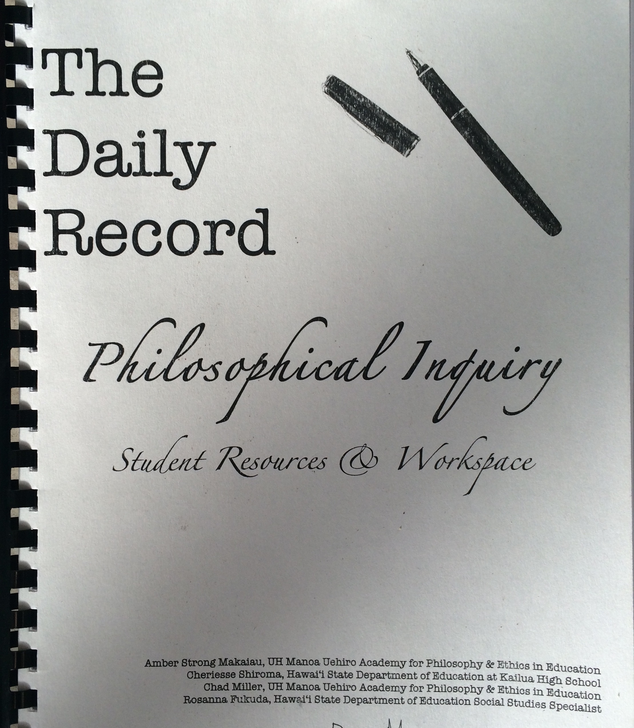
PHILOSOPHICAL INQUIRY
A brand new interdisciplinary social studies elective in the Hawaii State Department of Education aimed at developing students’ capacity to think as ethical members of their community.

Slide 18
Student Voices: Impacts of the p4cHI approach to deliberative pedagogy on student learning
Describe how this class, Philosophical Inquiry, provided you with the tools to help you make decisions in your future, including tough decisions that you are going to have to make when confronted with life challenges.
Philosophical Inquiry Pilot Class Focus Group Interview May 2015 (0:00 – 2:42)

Slide 19
Intellectual Safety

Slide 20
Making a Community Ball
Name
Give an example of something that you like to do when you are not being a social studies specialist.
In your unique position as a state social studies specialist – what are three things that you are most interested in collaborating and taking action on with this group?
Rules of the Community Ball
Person with the community ball is the speaker.
Person with the community ball chooses who speaks next.
You always have the right to pass.

Slide 21
Plain Vanilla: A process for deliberative dialogue & inquiry
Plain Vanilla Steps
Read (or some other stimulus)
Question
Vote
Write
Dialogue, Inquiry & Deliberation
Reflect & Evaluate

Slide 22
QUESTIONS?

