Slide 1
C3 Inspired Learning: Redefining How We Do Civic Education
Rosanna Fukuda
Hawaii Department of Education
Patricia Halagao
University of Hawaii at Manoa/Hawaii State Board of Education
Amber Strong Makaiau
University of Hawaii at Manoa
Maya Soetoro-Ng
University of Hawaii at Manoa
Notes:
Welcome to our interactive workshop today titled, “C3. . .” We will be together
for the next 2 hours, and during that time, you will have the opportunity to learn about. . .and experience. . .a number of ways we are using the C3 Framework in civics education in Hawaii. My name is Rosanna Fukuda, and I am the Educational Specialist for the Hawaii Department of Education. I am joined by 3 esteemed social studies educators fro the University of Hawaii. To my…. Is Dr. Patricia Halagao, Dr. Maya Soetor-ng, and Dr. Amber makaiau. If you are really interested, you can learn a bit more about each of us in the handout in the back.

Slide 2
Workshop Agenda
8:00 BACKGROUND
8:10 PROMPT OF THE DAY
8:45 CEEDS OF PEACE – Dr. Maya Soetoro-Ng
9:00 PERSPECTIVES FOR A DIVERSE AMERICA – Dr. Patricia Halagao
9:15 PHILOSOPHY FOR CHILDREN HAWAI‘I –Dr. Amber Makaiau
9:30 QUESTIONS
9:40 REFLECTIONS
10:00 MAHALO!
Notes:
In our workshop today we will be sharing how the C3 has inspired us and given us a framework for rethinking civic education in the state of Hawaii. Here is the agenda for today’s workshop. We will start by giving you a bit of background on how the four us came together. Next we will invite you to participate in a prompt day related to our workshop’s compelling questions. And then for the bulk of the presentation we will share three innovative approaches to civic education that currently being used in Hawaii. Then we will have an opportunity for your questions and reflection.

Slide 3
How did we get here?
Your
Notes:
So here is a little bit of history to describe how the four of us reconnected with one another. In the summer 2011….why did we value this so much? How do we connect with the community to an even greater value in social studies? This is our journery together to answer that question.

Slide 4
Compelling Question
What is civic education?
Supporting Questions:
Where is civic education represented in the C3 Framework?
What are some examples of how civic education is represented in the C3 Framework?
Notes:
CC for today and SQ

Slide 5
Prompt of the Day
Philosophical Inquiry Prompt of the Day: Reflect on the Prompt of the Day (POD) in writing. Use textual evidence and/or self-knowledge/experiences to support your response.
11/23/2014 POD:
What is civic education? (Compelling Question)
Where is civic education represented in the C3 Framework? (Supporting Question)
What are some examples of how civic education is represented in the C3 Framework? (Supporting Question)
Notes:
So before we share the work that we’ve been doing in Hawai‘i, we would like to invite you to share your thinking about civic education and the new ways in which the C3 Framework is inspiring social studies educators to rethink traditional notions of what constitutes civic education.
To facilitate this process we are going engage in learning activity that is a part of a brand new social studies course that we are currently piloting in the Hawaii State Department of Education. The course is an interdisciplinary social studies elective for high school students and it is titled, “Philosophical Inquiry.” The main focus of the course curriculum is teaching students how to think as ethical members of their community.
Each day in the course the students begin class with a “Prompt of the Day” and they end class with a Daily Reflection. They write these in their Philosophical Inquiry Daily Record on a handout that looks like this (show handout). You all should have picked one of these up at the front of the room.
What we would like you to do is engage in the activity in the same way that our students do. On your handouts we would like you to reflect on the prompt of the day in writing. Make sure to use textual evidence and/or self knowledge/experiences to support your response. In today’s workshop are prompt of the day is the one compelling question – what is civic education and the two supporting questions – where is civic education represented in the C3 Framework and what are some examples of how civic education is represented in the C3 Framework? So at this time, we would like you to take about five minutes to respond to these three questions in writing. Make sure to use textual evidence and/or self-knowledge/experiences to support your response. When you are done writing you will have the opportunity to share your responses out loud with the group.

Slide 6
Community Ball
Rules of the Community Ball:
Only the person with the community ball speaks.
The person with the community ball chooses who speaks next.
You always have the right to pass.
Notes:
So what we would like to do now is give you the opportunity to share one highlight from the prompt of the day that you just wrote. To facilitate this dialogue we are going to use a “community ball.” The community ball is a pedagogical tool that is used by students and teachers who practice p4cHawaii. The purpose of the community ball is to create a democratic classroom by distributing power, positioning the teacher as a co-inquirer, and mediate turn taking during deliberative dialogue. The rules of the community ball are…
So what we would like to do is have one person volunteer to share first, and then they will pick who speaks next, and those who want to speak can indicate that you would like to talk next by raising their hand.

Slide 7
Intellectual Safety
Notes:
One other thing before we start sharing – we would like to make sure that we maintain intellectual safety with one another. Intellectual safety is the idea that all participants in our workshop must feel like they can ask any question or make any comment as long as they are being respectful of everyone else in the room. As a part of this, please make sure that your sharing is brief and concise so that we can hear from as many voices as possible in the next 10 minutes.

Slide 8
Sharing Responses to the POD:
What is civic education?
Supporting Questions:
Where is civic education represented in the C3 Framework?
What are some examples of how civic education is represented in the C3 Framework?
Notes:
So who would like to get us started? – End by 8:43

Slide 9
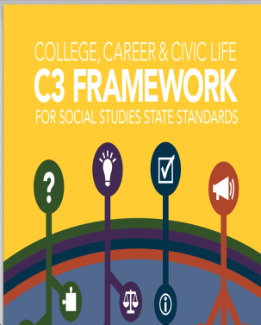
C3 Inspired: Rethinking Civic Education
CEEDS OF PEACE
Dr. Maya Soetoro-Ng
CIVIC MULTICULTURAL COMPETENCE
Dr. Patricia Halagao
PHILOSOPHY FOR CHILDREN HAWAI‘I
Dr. Amber Makaiau
Notes:
Summarize what people have shared and make a link to the following big idea…
In relationship to everything that the group just talked about, we would now like to share three different ways in which we have been rethinking civic education in Hawaii. They are the Ceeds of Peace, Perspectives for Diverse America, which is an example of Civic Multicultural Competence and Philosophy for Children Hawai‘i. As we share about each of these initiatives we would like you to rethink civic education alongside us, and to frame this rethinking we would like everyone to consider looking at the entire Inquiry arc of the C3 (not just dimension two and four) as civic education. The idea is that active participants in a democracy, in addition to learning about things like the three branches of government and the importance of taking civic action, also need repeated opportunities to learn how to think and care as an ethical member of their multicultural community. This is the reason why we are looking at each dimension of the C3 Framework is a vital component of civic education. When students graduate from high school knowing how to ask meaningful questions, make plans to answer their questions, apply what they know about different content areas to issues in their world, evaluate sources, draw conclusions and take action, then we believe they are prepared for life in a democratic society.
With that said, Maya will get us started by sharing the tremendous work that she is doing with Ceeds of Peace, and at the end of my presentation we would like to respond to questions that you have about any of the three initiatives.
Maya…

Slide 10
The Critical Cs of Peacebuilding
Dr. Maya Soetoro-Ng
University of Hawai‘i Manoa

Slide 11
History of Ceeds of Peace
2010-2011- Development of a Peacebuilding Workshop Focused on Children: Association for Conflict Resolution Hawai`i workshop: Raising Peacebuilders 360°
2011-2012- Responding to UH Student Evaluations: Maya and Kerrie develop Ceeds of Peace workshop series for communities
2012-2014-Partnering with the Department of Education: Ceeds of Peace Workshop series implementation aligned with Common Core, HCPSIII and GLOs
2014- Exploration of piloting to scale in two complex areas

Slide 12
Planting, Nurturing and Harvesting the CEEDS of PEACE
(Between)
Connection
Critical Thinking
Creativity
Conflict Resolution
Communication
Careful Listening
Collaboration
(Within)
Compassion
Courage
Confidence
Calm Reactions
Curiosity
(In Service)
Community
Call to Lead/Catalyst
Civic Engagement
Commitment
Conservation
Life Ready Problem Solvers

Slide 13
Goals
To bring together families, community organizations and school staff to learn the ceeds and strategies for raising peacebuilders.
To support teachers in integrating the ceeds of peace into existing curriculum and provide them with professional development opportunities.
To support families and community organizations in planting, nurturing and modeling the ceeds in their every day lives with their children.
To build bridges between home and school, ensuring children are hearing and seeing similar messages about peacebuilding in both places.
To raise generations of peacebuilders who can effectively problem solve the complex issues facing our communities.

Slide 14
Ceeds for Hawai‘i:
Barriers to Peace: a snapshot
In Hawai‘i
Unresolved indigenous rights issues
7th highest poverty rate in the U.S.
2nd in nation for meth related treatment admissions
Persistent school violence
Since 1997, Hawai‘i has topped the national average in domestic-violence homicides per capita
6,000 reported cases of child abuse per year
Around the World
37 current armed conflicts, millions killed, 75% of victims are non-combatants
195 million children have stunted development due to malnutrition
2.5 million people trafficked every year, 80% of them women and girls, 79% of them for sexual exploitation
Ceeds for the World
Why Plant?
Why Now?
Notes:
Stephen Pinker, Harvard Professor- The Better Angels of Our Nature- Why Violence Has Declined
Hawaii Free Press, 11.15.2012, .http://www.hawaiifreepress.com/ArticlesMain/tabid/56/articleType/ArticleView/articleId/8221/Census-Bureau-Hawaii-7th-Highest-Poverty-Rate-in-US.aspx
http://dartcenter.org/content/crossing-line-abuse-in-hawai’i-homes#.URQwVjk5v78- originally Honolulu Advertiser analysis
SAMHSA, Treatment Episode Data Set 2008. Released in 2010.
Hawaii Children’s Trust Fund 2012
Uppsala Armed Conflict Dataset http://www.pcr.uu.se/research/ucdp/datasets/ucdp_prio_armed_conflict_dataset/
Worldhunger.org
UN Women, 2012 update

Slide 15
Why 360°?
360° Influence
Home
School
Community
360° Thinking
Critical
Compassionate
Creative
Collaborative
Courageous
Conflict Resolving
To achieve peaceful and thriving communities….

Slide 16
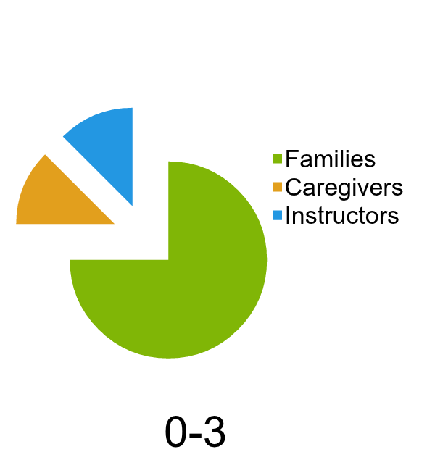
Average Hours We Spend With Children
School Age
Notes:
Full of Life https://www.youtube.com/watch?v=jd7YWx7idfE
These percentages will obviously vary based on each family. If a child is in after school care for example, the percentage of time with caregivers and instructors increases. Notice the dramatic shift from time spent with parents to teachers at ages 4-5.

Slide 17
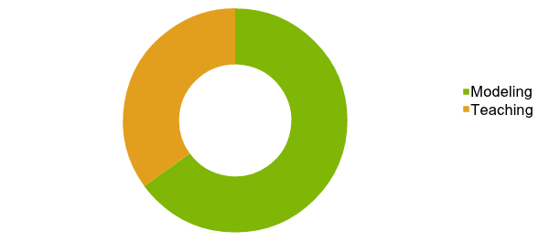
The power of…..
Notes:
http://www.youtube.com/watch?v=6JfHB2cruJU- Kids See Kids Do
http://www.youtube.com/watch?v=WjpBa_4tXmM- wanna be like you
http://www.youtube.com/watch?v=LqJnk-jYWRM- 4th grade trailer
In this month’s The Mind by Scientific American, Robert Epstein presents the results of a research study of 2,000 parents about what makes a good parent.Psychologists have found that children really "do as parents do, not as they say." Being a positive role model for good behavior is far more powerful than specific training or disciplinary measures in raising children. These processes of identification and imitation overshadow any statements, rules, and prescriptions for good behavior. Children develop behaviors through observing their parents in day-to-day life. Every behavior that a parent engages in should be worthy of imitating because children will imitate it.Bruno Bettelheim's observed, “While most parents are ready to teach their children discipline and know that they are the ones to do so, they are less ready to accept the idea that they can teach only by example.” Parents who are congenial, non-defensive, nonintrusive, consistent, and generous have a positive impact on their child's personality. The fact that our children are looking to us to see how to be is enough of a reason for us to focus on our development as a person. Only if we have developed integrity in the way we live our own lives will we be able to provide our offspring with the necessary model for mature, adult functioning.
http://www.psychologytoday.com/basics/education

Slide 18
Action Plan Framework
Prepare the Soil
Envision the Harvest
Pull the Weeds
Plant the Ceeds
Nurture to Sustain

Slide 19
Prepare the Soil inquiry and discovery
Ceeds | Tools
Careful Listening | Double Listening Open Ended Questions
Compassion | What Would They Say? Exercise in Empathy
Critical Thinking | Identify Needs and Interests Listen for Core Team
Community | Deconstruct Cast the Net

Slide 20
Envision the Harvest create the future
Ceeds | Tools
Critical Thinking | Think, Pair, Listen, Share Change the Ending
Creativity | Paint and Post the Future Create Shared Values
Community | Canoe Travel Talking Sticks

Slide 21
Pull the Weeds barriers to peace
Ceeds | Tools
Critical Thinking | Shared Story Media Systems Analysis
Compassion | From the Source Storytelling Try It On
Careful Listening | Double Listening Restorative Justice Circle

Slide 22
Plant the Ceeds for prevention
Ceeds | Tools
Careful Listening | Ekphrastic Poetry (hear the message) Weekly Family Meetings
Compassion | Try It On Literature
Critical Thinking | Facing History in Ourselves Doubting and Believing
Complex Problem-Solving | Consensus Building Rewind Game
Creativity | Media comparisons
Collaboration | Shared Decision-making Pacts Shared Values/Commitments
Courage | Role Play My Kuleana
Community | Cast the Net Pohaku Bowls

Slide 23
Plant the Ceeds for intervention
Ceeds | Tools
Careful Listening | Talking Stick Weather Ball
Compassion | Switch Seats
Critical Thinking | Reflect and Reenter Paths to Resolution
Complex Problem-solving | Shuttle Diplomacy Peace Rose Mediation/Facilitation processes
Creativity | Engage Nature Movement Healing
Collaboration | Ho‘oponopono
Courage | Power of the Bystander
Community | Restorative Justice

Slide 24
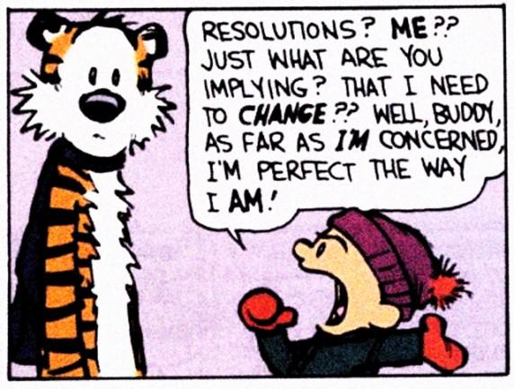
Plant the Ceeds for sustained resolution
Contracts/Pacts
Sincere and Sustaining Apologies
Next Time Commitments
Peer Messaging
Taking Temperature
Monitoring and Evaluation
Go see ceedsofpeace.org

Slide 25
Civic Multicultural Competence
Dr. Patricia Halagao
Divergence of Social Studies and Multicultural Education
Seeking Convergence: Civic Multicultural Competence (CMC)
Perspectives for a Diverse America
Rethinking C3 Framework
Practicing Civic Multicultural Competence
Notes:
Backdoor

Slide 26
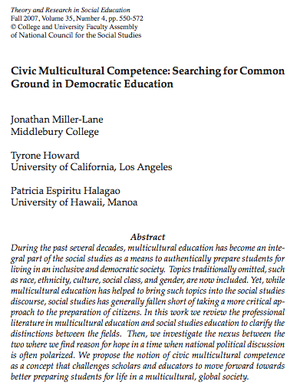
Notes:
2007 article proposed creating a new concept, CMC, REVISIT
Example of CMC – TT’s PDA
Always familiar with TT as a first grade teach in Oakland, invited to participate in a pilot study of PDA

Slide 27
Divergence of SS and MCE
If both fields are interested in the education of citizens and ensuring the continuation of democracy, why does there seem to be a disconnect in practice?
Notes:
Begin with comparing two fields

Slide 28
The Power of Language
Civic Education
Democracy
Citizen
Duty
Public Good
Equality
Justice
Democratic Education
Multicultural Education
Diversity
Marginalized
Care
Inclusion, Community
Equity
Social Justice
Culturally Relevant Education
Notes:
One area of disconnect/schism can be seen in the kind of language the different disciplines use.
We may be talking about similar goals, but the concepts and discourse we use are similar, yet different.
Not only pay attention to what is said, but who is saying it. The perspectives AND history behind usage of words.
Traditionally…
Justice – matter of equal opportunities for every individual to pursue
Social Justice – equal access and equity (addressing specific needs of disenfranchised groups)
As Antonia Darder said, “We must conduct vigilent reflection of how we use language.”
Challenge the dichotomy

Slide 29
Nature of the Disconnect
Is it a matter of degree or a different vision of the nation?
The cause may be due to the range of possible responses in each field to the question: What should education for democratic citizenship include?

Slide 30
Pedagogy
Critical
A critical, inquiry collaborative
approach to understanding
historical & contemporary
conditions
Non- Critical
Transmission of official history
and narrative is stressed.
Notes:
Look at how civic education and us history is being taught

Slide 31
Vision of United States
Diversity
USA is on a path to fulfilling its promise. Diversity informs democracy through challenge and struggle.
Unity
USA is an accomplished democracy and early founders unified diverse colonies. It stresses a common political framework over cultural differences. Diversity threatens unity.
Notes:
Overlaid with vision of United States
Are we an achieved democracy or are we on a path?
Attitudes

Slide 32
Intersections of MC & SS Education
Diversity
USA is on a path to fulfilling its promise. Diversity informs democracy through challenge and struggle.
Critical
A critical, inquiry collaborative
approach to understanding
historical & contemporary
Conditions.
Non- Critical
Transmission of official history
and narrative is stressed.
Unity
USA is an accomplished democracy and early founders unified diverse colonies. It stresses a common political framework over cultural differences. Diversity threatens unity.
Notes:
Critical-Diversity – Banks, Parker’s notions of democracy and difference
Non-critical – Diversity – Hirsch disadvantaged background lack cultural literacy
Non-critical – Unity – “citizenship transmitters”
Critical-Unity – Gagon – lauds achievement of Western civiclization, but examine root causes, effects and shortcomings of those achievements

Slide 33
Civic Multicultural Competence
“the desire and ability to investigate diverse, problematic, and controversial issues in pursuit of a more inclusive, just, and equitable society. It is fostered through critical, inquiry-based, and collaborative study of the dynamic interplay between historical and contemporary conditions – whether local, national, or global – and by applying what is learned through authentic, self-motivated, and social justice-oriented acts.” (p. Miller-Lane, Howard & Halagao, p. 562)
Notes:
Tensions and disagreements are inherent and welcomed in a diverse, democratic, multicultural society.
Deep care and commitment to humanity.

Slide 34
Civic Multicultural Competence
“the desire and ability to investigate diverse, problematic, and controversial issues in pursuit of a more inclusive, just, and equitable society. It is fostered through critical, inquiry-based, and collaborative study of the dynamic interplay between historical and contemporary conditions – whether local, national, or global – and by applying what is learned through authentic, self-motivated, and social justice-oriented acts. (p. Miller-Lane, Howard & Halagao, p. 562)
Notes:
Tensions and disagreements are inherent and welcomed in a diverse, democratic, multicultural society.
Deep care and commitment to humanity.

Slide 35
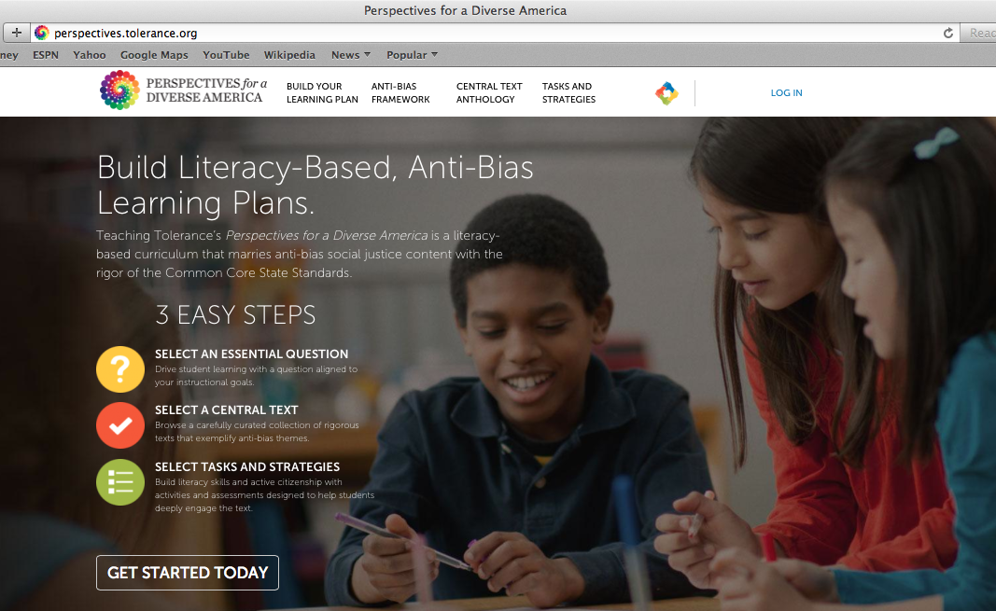

Slide 37
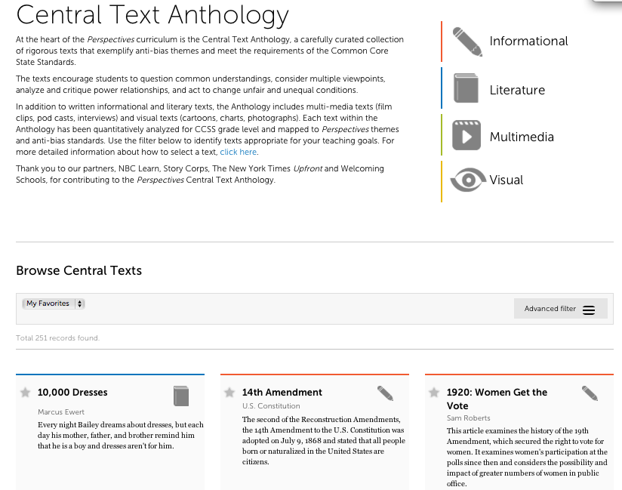

Slide 38
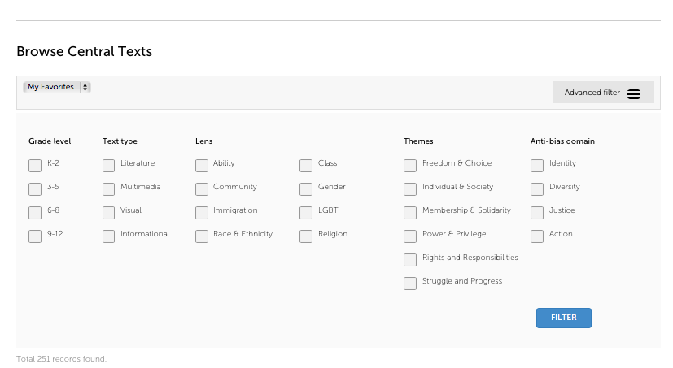
Notes:
Content, inquiry
What is the content? What do you inquire about?
Metcalf’s “Closed areas”
Social studies themes

Slide 40
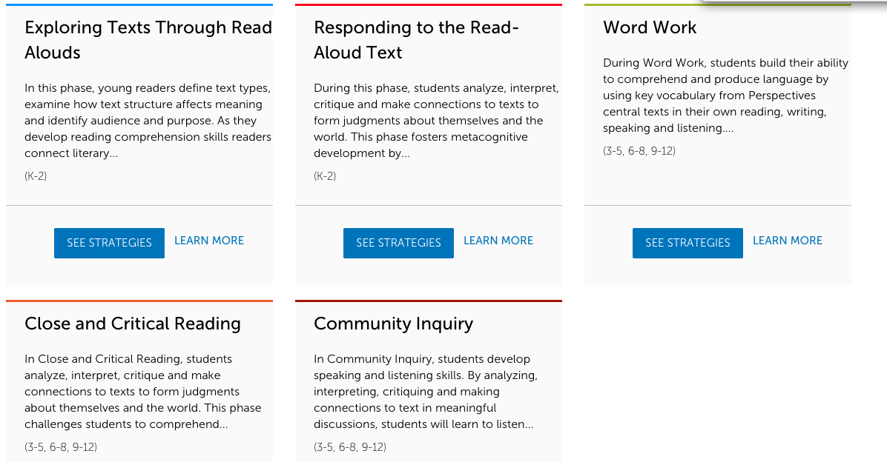

Slide 42
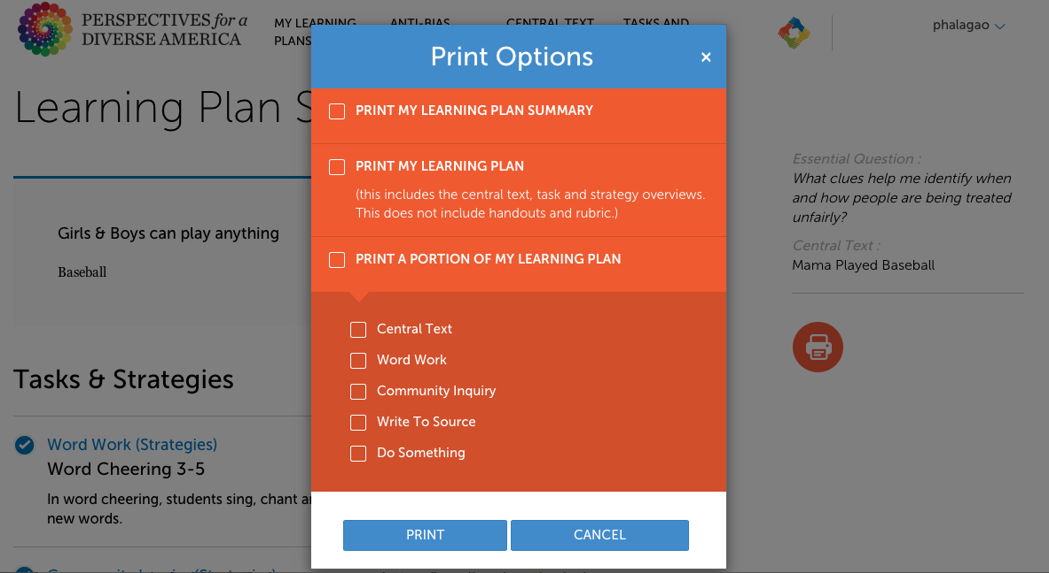

Slide 43
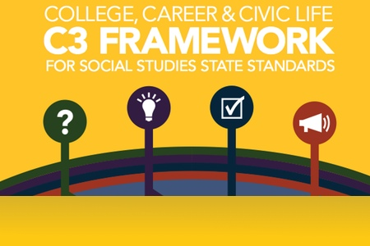
CMC, C3, Perspectives
“…investigate diverse, problematic, and controversial issues in pursuit of a more inclusive, just, and equitable society…critical, inquiry-based, and collaborative study of historical and contemporary, local , global…applying authentic, self-motivated, and social justice-oriented acts.”
Notes:
So how do these two initiatives connect, overlap?

Slide 44
Practicing Civic Multicultural Competence
www.perspectives.tolerance.org
Notes:
Not going to lie and admit this is easy work
Even in Hawaii, need to be tolerant. Indications – Asian/Pacific islanders majority, highest multi-ethnic families/ marriages, indigenous revival, reputation Aloha state, we have disparities.
While Hawaii was # to pass gay marriage, Issues around sexuality, LGBT issues forefront, which almost derailed PDA

Slide 45
PHILOSOPHY FOR CHILDREN HAWAI‘I (p4cHI) Dr. Amber Strong Makaiau
My Connection to p4cHI
p4cHI – A Deliberative Pedagogy
Aims and Impact of the p4cHI Approach
Philosophical Inquiry
Notes:
I’m now going to talk about Philosophy for Children Hawai‘i (p4cHI). I will start by explaining what p4cHI is, and in relationship to the focus of this workshop, how P4C is a deliberative pedagogy, which caries out Dewey’s (1916) assertion that in order for democracy to function as it should, students must have opportunities to experience democracy in schools. This will lead into a brief overview of the aims and impacts of the p4cHI approach to education, and I will end by sharing a little bit more about the brand new course that we are piloting in the HIDOE called Philosophical Inquiry.

Slide 46
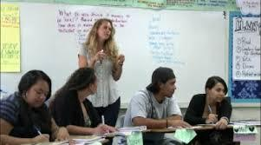
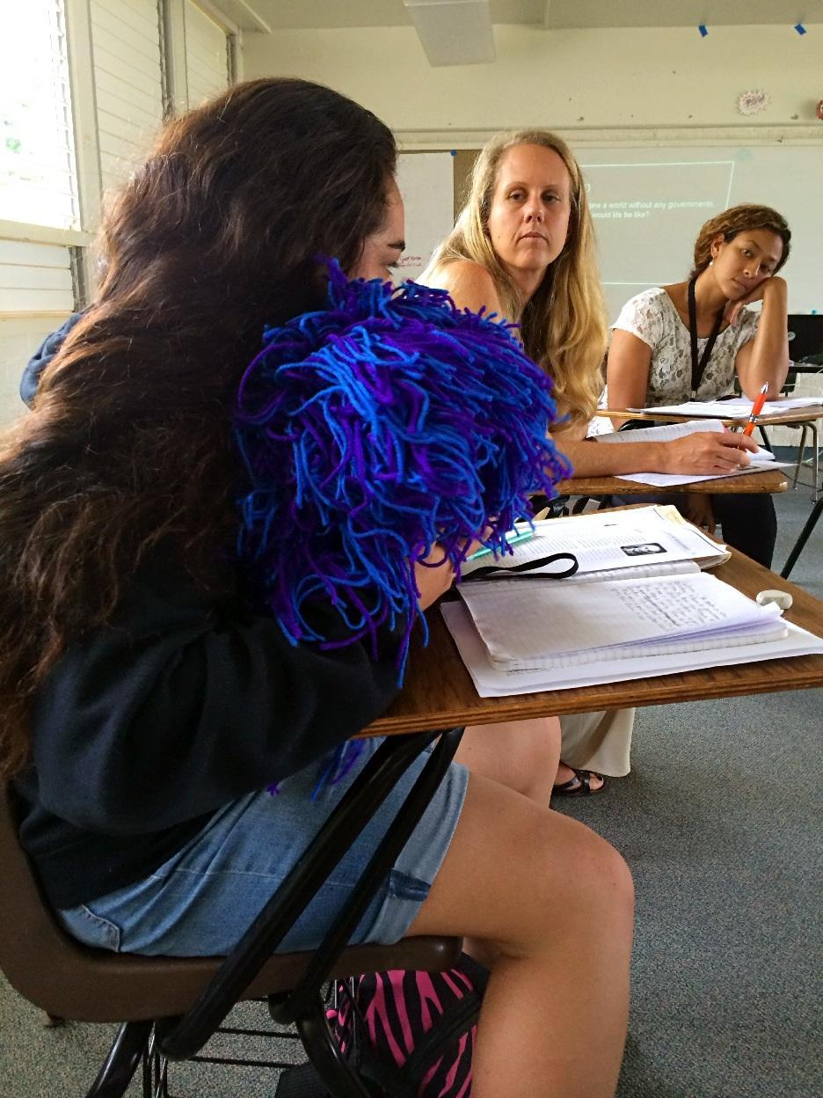
My Connection to p4cHI
Notes:
I was a high school social studies Teacher for over ten years in the Hawaii State Department of Education
I first learned about p4cH when I was in my Masters in Education Teaching Program
I was attracted to p4cH because it was the first time I was exposed to set of classroom activities that mirrored my theoretical beliefs about teaching and learning
When I was young, I went to a John Dewey elementary school and based on my own experiences with this type of education, I deeply believed in the power of creating learner-centered classrooms where students got to EXPERIENCE the things they were learning about. And in the bigger picture I wanted schools to be a place that promoted life in a democratic society, social justice, and personal transformation. In my eyes p4cH was an excellent approach for translating these theories about teaching, learning, and education into a classroom practice.

Slide 47
philosophy for children Hawai‘i (p4cH) is an approach to teaching and learning that is defined by a conceptual framework AND a set of activities

Slide 48
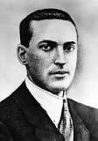
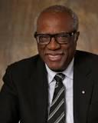
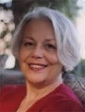
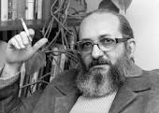
p4cH Conceptual Framework The Four Pillars of p4cH
Community Inquiry Philosophy Reflection
Notes:
At the core of the p4cH approach to education are the four pillars: community, inquiry, philosophy and reflection. Each of these concepts is linked to a number of theoretical foundations and theorists. For example:
Community – social constructivism (Vygotsky), culturally-responsive teaching (Gay), multiculturalism (Banks), Sonia Nieto (multicultural/culturally responsive)
Inquiry – learner-centered and experienced-based (Dewey), community of inquiry (Lipman), Myles Horton – Highlander Folk School
Reflection – reflective dialogue (Friere), reflective practitioners (Schon), meta-cognition (Costa)
Philosophy – next slide

Slide 49
What do we mean by philosophy?
Big P & little p
Notes:
Big P – academic, The Canon, learning about the thoughts of others (e.g. Plato, Aristotle, Confucius)
Little p – in little p the emphasis is on activity, on doing. Like all philosophy, it begins in wonder - our own deep wonder about ourselves and the world. We help refine this wonder with cognitive tools to help us think/question more deeply about our own experiences and the content of school subjects like science, math and history.

Slide 50
What are the implications of philosophy as an activity?
philosophy becomes a way for students and teachers, of any age group, to engage with “content” in a variety of learning contexts
Notes:
And in my case I used the p4cHI approach to engage in social studies content such as U.S. History, psychology, global studies, ethnic studies.

Slide 51
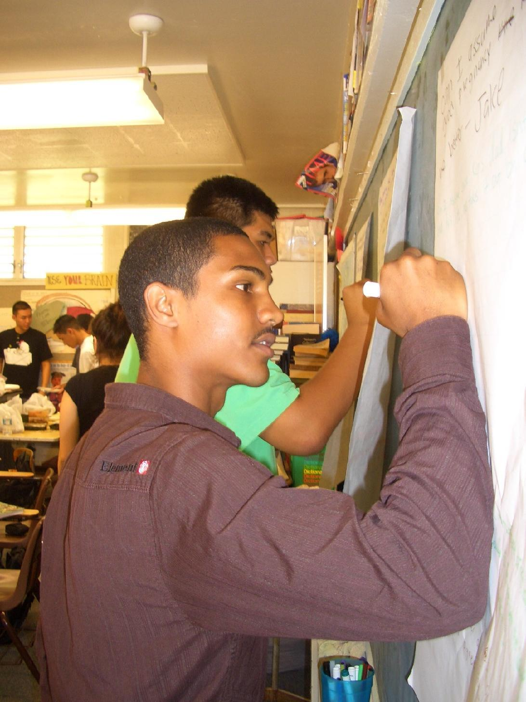
p4cHI Activities
Intellectual Safety
Community Ball
Good Thinker’s Tool Kit
Plain Vanilla Inquiry Discussions
Magic Words
Evaluation of the Community of Inquiry
Notes:
So, in addition to having a strong theoretical base, there are number of key p4cHi classroom activities that assist students and teachers in engaging in the activity of philosophy in the classroom. These activities are…
We experienced intellectual safety and the community ball at the beginning of this workshop so I will share a little bit more about the good thinker’s tool kit and plain vanilla, both of which support student-centered inquiry and deliberative dialogue in the classroom.

Slide 52
The Good Thinker’s Tool Kit
W – What
What do you mean by..?
R- Reasons
What are the reasons..?
A- Assumptions
Is it reasonable to assume..?
I – Inferences
Is it reasonable to infer ___ from __?
T- Truth
Is what’s being said true? What are the implications?
E- Examples
What are some examples of..?
C- Counter-Examples
What are some counter-examples to..?
Notes:
The Good Thinker’s Tool Kit is an instructional strategy that makes thinking explicit by giving students and teachers language for articulating their thinking. It includes seven “philosophical thinking moves.” They are…
The students are taught the Good Thinker’s Tool Kit at the beginning of the school year and then they are expected to use the tool kit to ask questions and construct claims as an everyday part of their learning. There are a variety of ways that teachers can incorporate the tool kit into their lessons including writing assignments and class discussions.

Slide 53
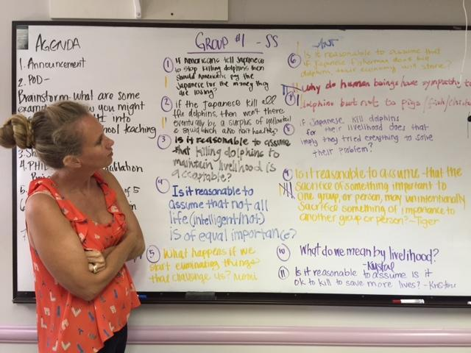
Plain Vanilla: A Process for Deliberative Philosophical Dialogue
Plain Vanilla Steps
Read/Observe/Experience
Question
Vote
Inquiry
Reflect/Evaluate
Notes:
This leads to the Plain Vanilla discussion strategy. Plain vanilla is a process that we use to initiate deliberative philosophical dialogue in the classroom. This is how it works…
Plain vanilla is an excellent strategy for creating democratic classrooms because it positions students and teachers as co-inquirers who are working together to resolve real world problems through deliberation and dialogue

Slide 54
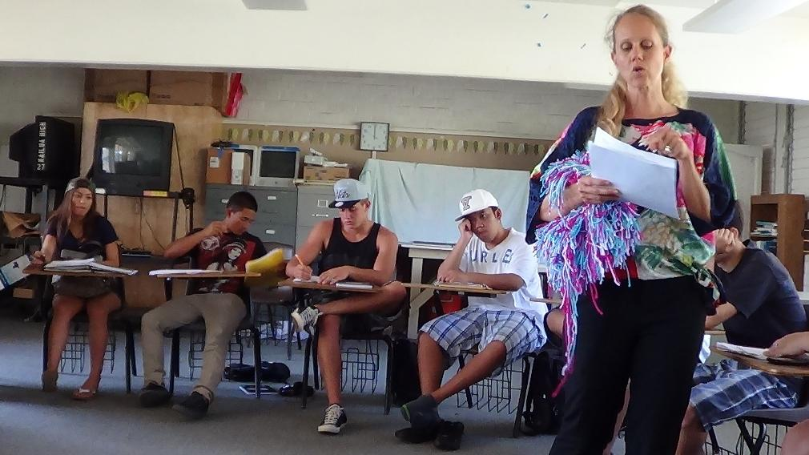
The Philosopher’s Pedagogy
Six teacher commitments:
Live an examined life.
Approach education as a shared activity between teacher and student.
See “content” as learner/teacher beliefs + learner/teacher experiences + subject matter
View philosophy as “the general theory of education”
Make philosophy a living classroom practice
Challenge contemporary measures of assessment
Notes:
Now it is also important to point out that in order for teachers to effectively carry out the p4cHi activities that I’ve described they must make a set of commitments in their practice. We are calling these the six commitments of the philosopher’s pedagogy. They are…

Slide 55
Aims of p4cHI
Good Judgment
Responsible & Ethical Community Member
Philosophical Reflection
Empathy
Joyous Learning
Transformative Experience
Notes:
And we put all of this together (the theory behind p4cHI, the activities, and the philosopher’s pedagogy) what we are hoping to create with p4cHI are teachers and students who:

Slide 56
The Impact of a p4cHI Approach
good thinkers
ethical and moral development
multiculturalism
tolerance and empathy
deliberative democracy
Notes:
And what we’ve seen throughout the years of practicing and research p4cHI is that there are some very observable outcomes of the p4cHI approach. Students and teachers become:
-better thinkers
-they develop their own abilities to make ethical and moral judgments
-they gain multicultural competency, including the ability to see an articulate multiple points of view and perspectives
-they become more tolerant and empathetic
-and they come to come to see themselves as active participants in a deliberative democracy

Slide 57
PHILOSOPHICAL INQUIRY
Philosophical Inquiry brand new interdisciplinary social studies elective being piloted in the Hawaii State Department of Education. It is a collaboration between the UH Uehiro Academy and the HIDOE. The primary focus of the course is learning how to think as an ethical member of a community. p4cHI, the C3 Framework, and the Common Core were used to write the standards for the course.
Notes:
I want to finish my sections by sharing a little bit more about philosophical Inquiry, which is one of our current p4cHI projects in Hawaii. READ SLIDE

Slide 58
Philosophical Inquiry Course Objectives
Complex problem solving, critical thinking, good judgment, reasoning, inter-personal communication, personal reflection, group facilitation, note-taking, and writing skills
Ethical relationship building, and dispositions necessary for thinking responsibly as a member of a reflective community of inquiry
Interdisciplinary methods for conducting research
Thinking philosophically about historical, economic, geographic, and political science content, issues and concepts
Engagement and wonderment in the learning process, and connecting thinking across content areas and other areas of life
Habits of mind needed for meaningful and purposeful engagement in students’ current and future schoolwork and life
Notes:
The objectives of the course are..

Slide 59
Philosophical Inquiry Pilot Course Outline/Units of Study
Creating a Community of Inquiry and Daily Practices
The Ten Lenses of Philosophical Inquiry
Philosophical Inquiry: Race & Politics
Philosophical Inquiry: Class & The Environment
Philosophical Inquiry: Gender & Society
Reflection, Assessment, and Future Action
Notes:
Right now it is being piloted at a small public high school on the windward side of the island of Oahu, and in this iteration of the course, the teacher who is teaching the class has worked with me to outline the class with the following units.

Slide 60
Philosophical Inquiry Student Reflections
Most importantly this class has taught me how to be a more respectful and responsible person. – Senior Female
Philosophical Inquiry is a class that opened up my mind to what’s going on in the world and how people understand and see things differently. – Senior Male
What I learned in class that will help me with my future is not being afraid to express my thoughts. When I first started this class I felt like what I wanted to say wasn’t right. I felt un-comfortable. After like the third week I actually got the feel of it. I became more and more engaged into expressing my feelings. – Senior Female
My first experience in Philosophical inquiry was awesome; my mind was challenged to a whole other level of thinking. I never thought that a class and I could have that much thinking power. – Senior Male

Slide 61
QUESTIONS?

Slide 62
Daily Reflection
WRITE:
How does what you learned today connect to your life and the world you live in? Do you see a different perspective or point of view? Use textual evidence AND ideas/quotes from classmates/teacher to support your response.
SHARE:
Select one reflection to share with the participants in this workshop.
Notes:
So we wanted to end our workshop today by having you reflect on what you learned in writing, and then again, like we did at the beginning of the session we would like to provide you with the opportunity to use the community ball to share your responses.
So take about five minutes to write your reflections on the back of your prompt of the day sheet. Think about (READ) and then we will have about 15 minutes to share our responses.

Slide 63
Mahalo
www.perspectives.tolerance.org
www.p4chawaii.org
www.ceedsofpeace.org
Notes:
www.ceedsofpeace.org
p4chawaii.org
perspectives.tolerance.org

