Slide 1
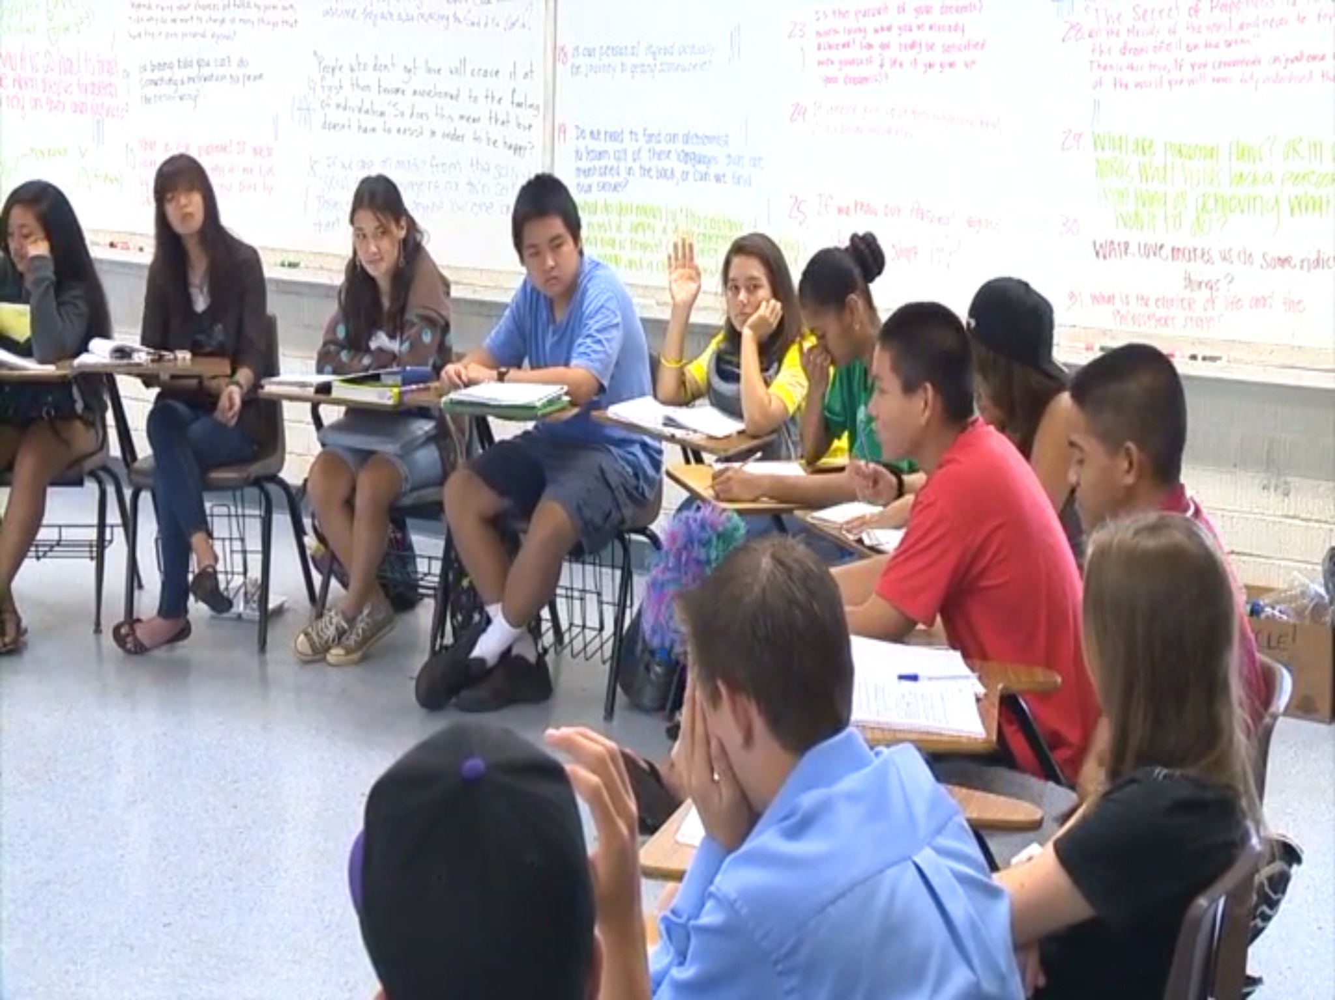
philosophy for children Hawai‘i
Dr. Amber Strong Makaiau
University of Hawai‘i Uehiro Academy for Philosophy & Ethics in Education

Slide 2
VISION: Education for the purpose of creating intellectually responsible communities
MISSION: We are dedicated to preparing, supporting and sustaining, educators, researchers, and students who engage or are interested in engaging in philosophy for children Hawai‘i worldwide

Slide 3
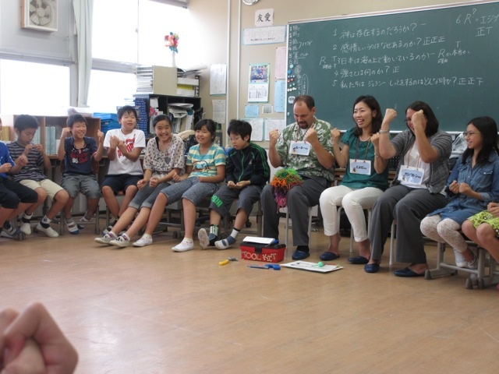
philosophy for children Hawai‘i in Japan

Slide 4
philosophy for children Hawai‘i
philosophy for children Hawai‘i (p4cHI) is an approach to teaching and learning that is defined by a conceptual framework (community, inquiry, philosophy, and reflection) and an accompanying set of activities

Slide 5
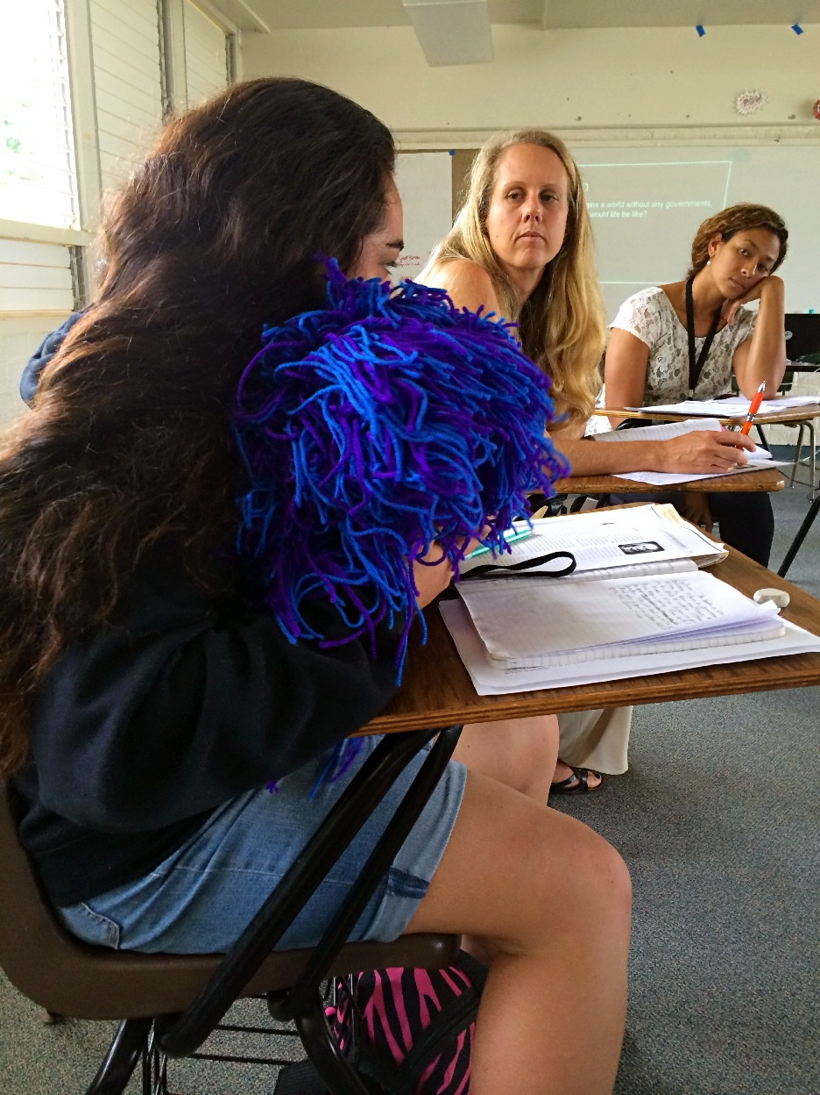
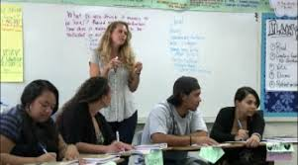
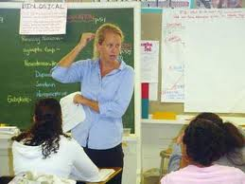
My Connection to p4cHI

Slide 6
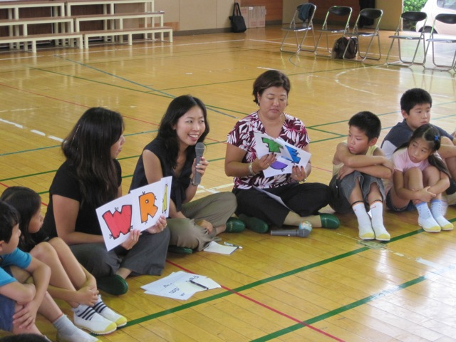
Presentation Outline:
What is p4cHI?
Conceptual Framework
Key Activities/Strategies
Role of Teachers
Participant Outcomes
A “Citizen’s Education”
Current Projects

Slide 7
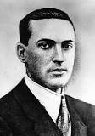
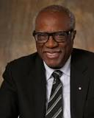
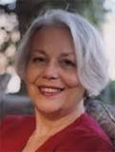
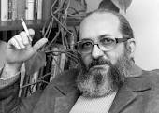
p4cHI Conceptual Framework The Four Pillars of p4cHI
Community Inquiry Philosophy Reflection

Slide 8
What do we mean by philosophy?
Big P & little P

Slide 9
What are the implications of philosophy as an activity?
philosophy becomes a way for students and teachers, of any age group, to engage with “content” in a variety of learning contexts

Slide 10
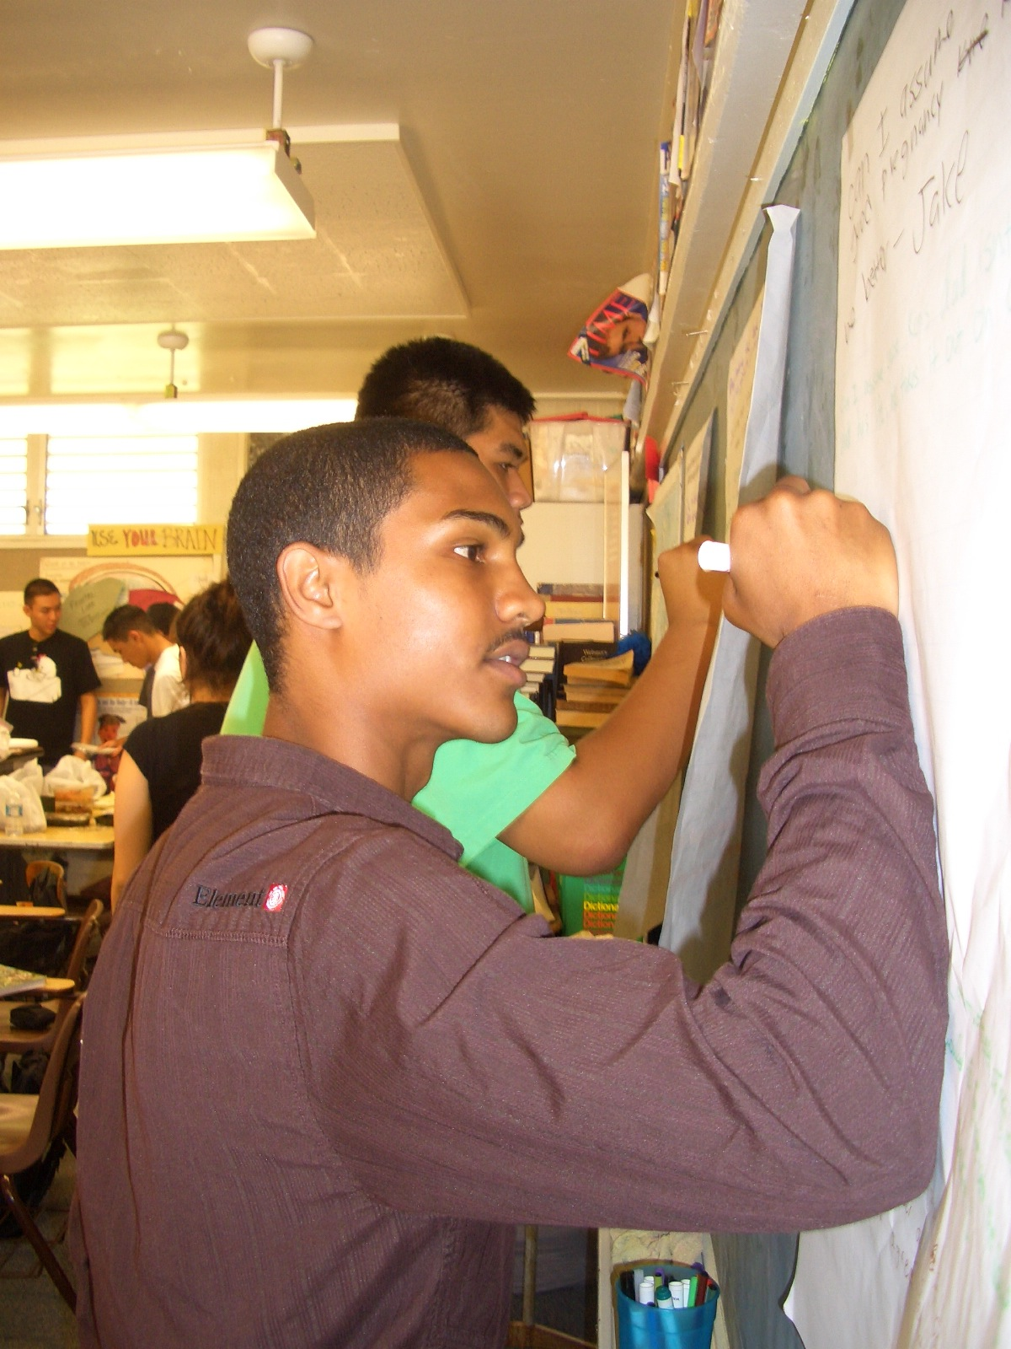
p4cHI Activities
Intellectual Safety
Community Ball
Good Thinker’s Tool Kit
Plain Vanilla Deliberative Inquiries
Magic Words
Evaluation of the Community of Inquiry

Slide 11
Intellectual Safety

Slide 12
The Community Ball

Slide 13
The Good Thinker’s Tool Kit

Slide 14
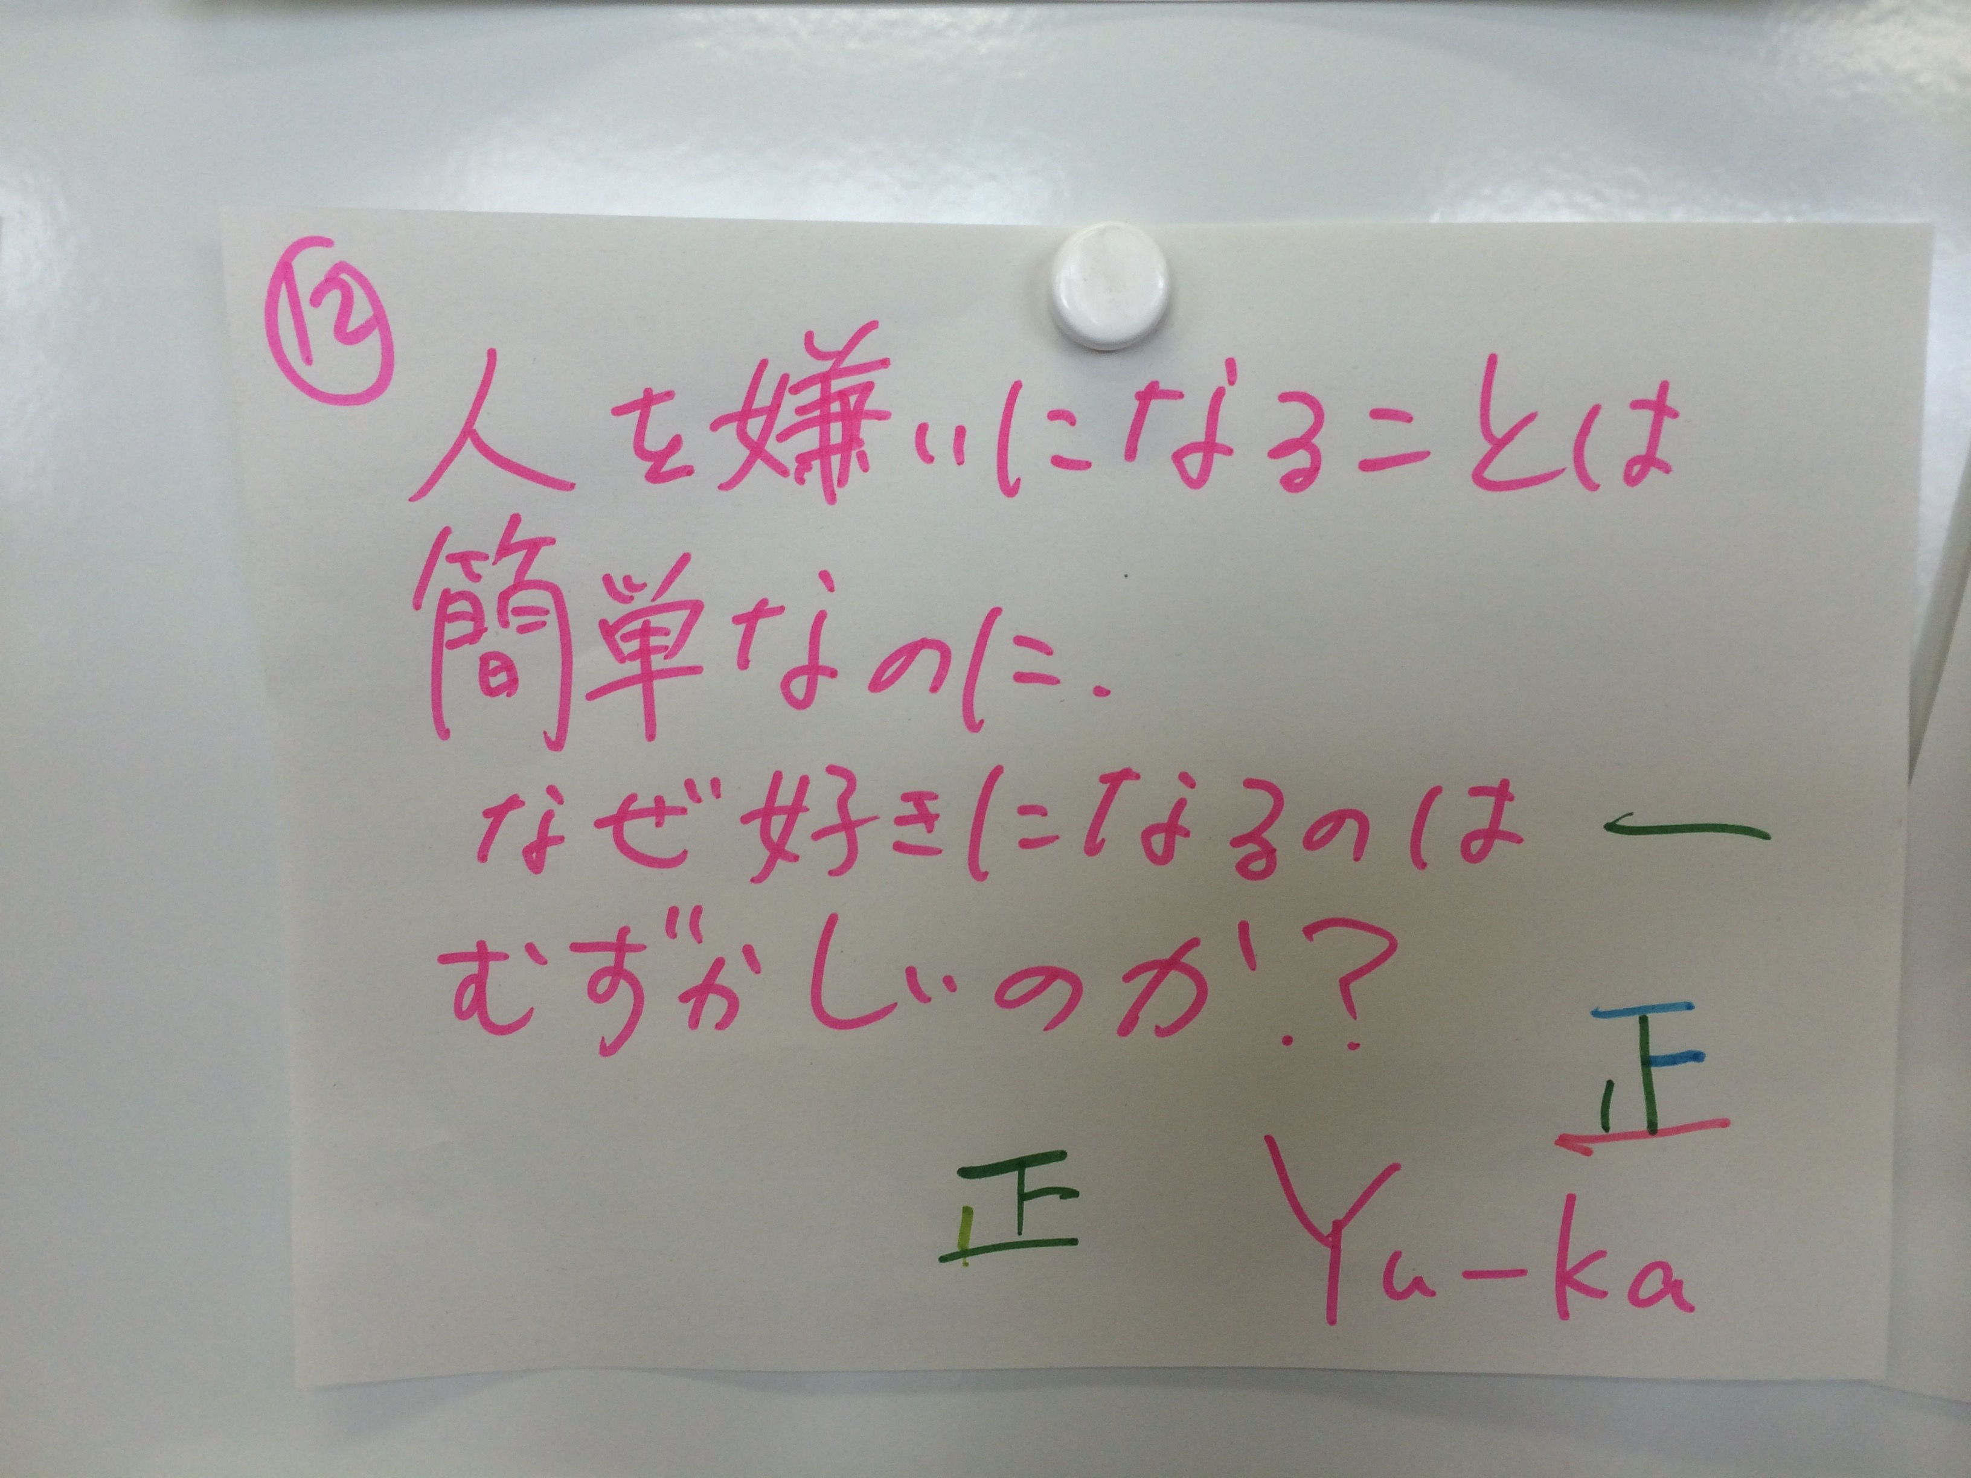
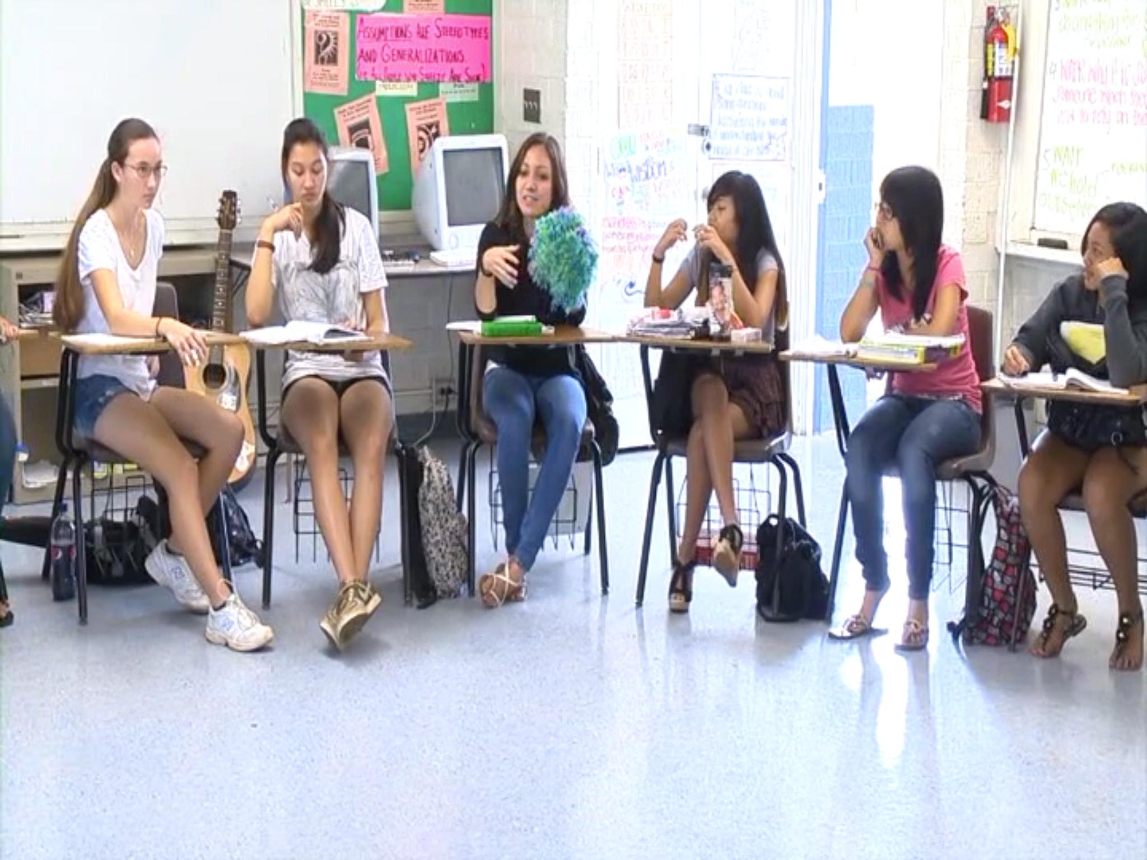
Plain Vanilla

Slide 15
Magic Words

Slide 16
Evaluation: Community and Inquiry

Slide 17
The Philosopher’s Pedagogy
Six Teacher Commitments:
Live an examined life
Approach education as a shared activity between teacher and student
See “content” as learner/teacher beliefs + learner/teacher experiences + subject matter
View philosophy as “the general theory of education”
Make philosophy a living classroom practice
Challenge contemporary measures of assessment

Slide 18
Outcomes of the p4cHI Approach to Education
Good Judgment
Responsible & Ethical Community Member
Philosophical Reflection
Empathy
Joyous Learning
Transformative Experience

Slide 19
From Civics to a Citizen’s Education

Slide 20
p4cHI is a “Deliberative Pedagogy” that supports students and teachers in their efforts to realize a “Citizen’s Education”

Slide 21
The p4cHI Approach to Deliberative Pedagogy
Ask meaningful, relevant, and purposeful philosophical questions;
Explore questions, topics, and problems of democracy (Matthews 2014) that are important and interesting;
Access sources of information representing multiple view points and cultural backgrounds;
Think about complex topics with diverse groups of people;
Reason for themselves;
Engage in deliberative dialogue;
Listen with empathy;
Treat others with respect;
Read and write;
And take responsible action when it is just and necessary

Slide 22
Education for Virtue, Character, Moral, and Social Responsibility

Slide 23
Current Projects of the Uehiro Academy
Model Schools
Philosophical Inquiry
p4c Sendai
Junior Philosopher in Residence
Pre-Service Teacher Preparation
Creating Communities for Ethical Research
Community Partnerships

Slide 24
MODEL SCHOOLS

Slide 25
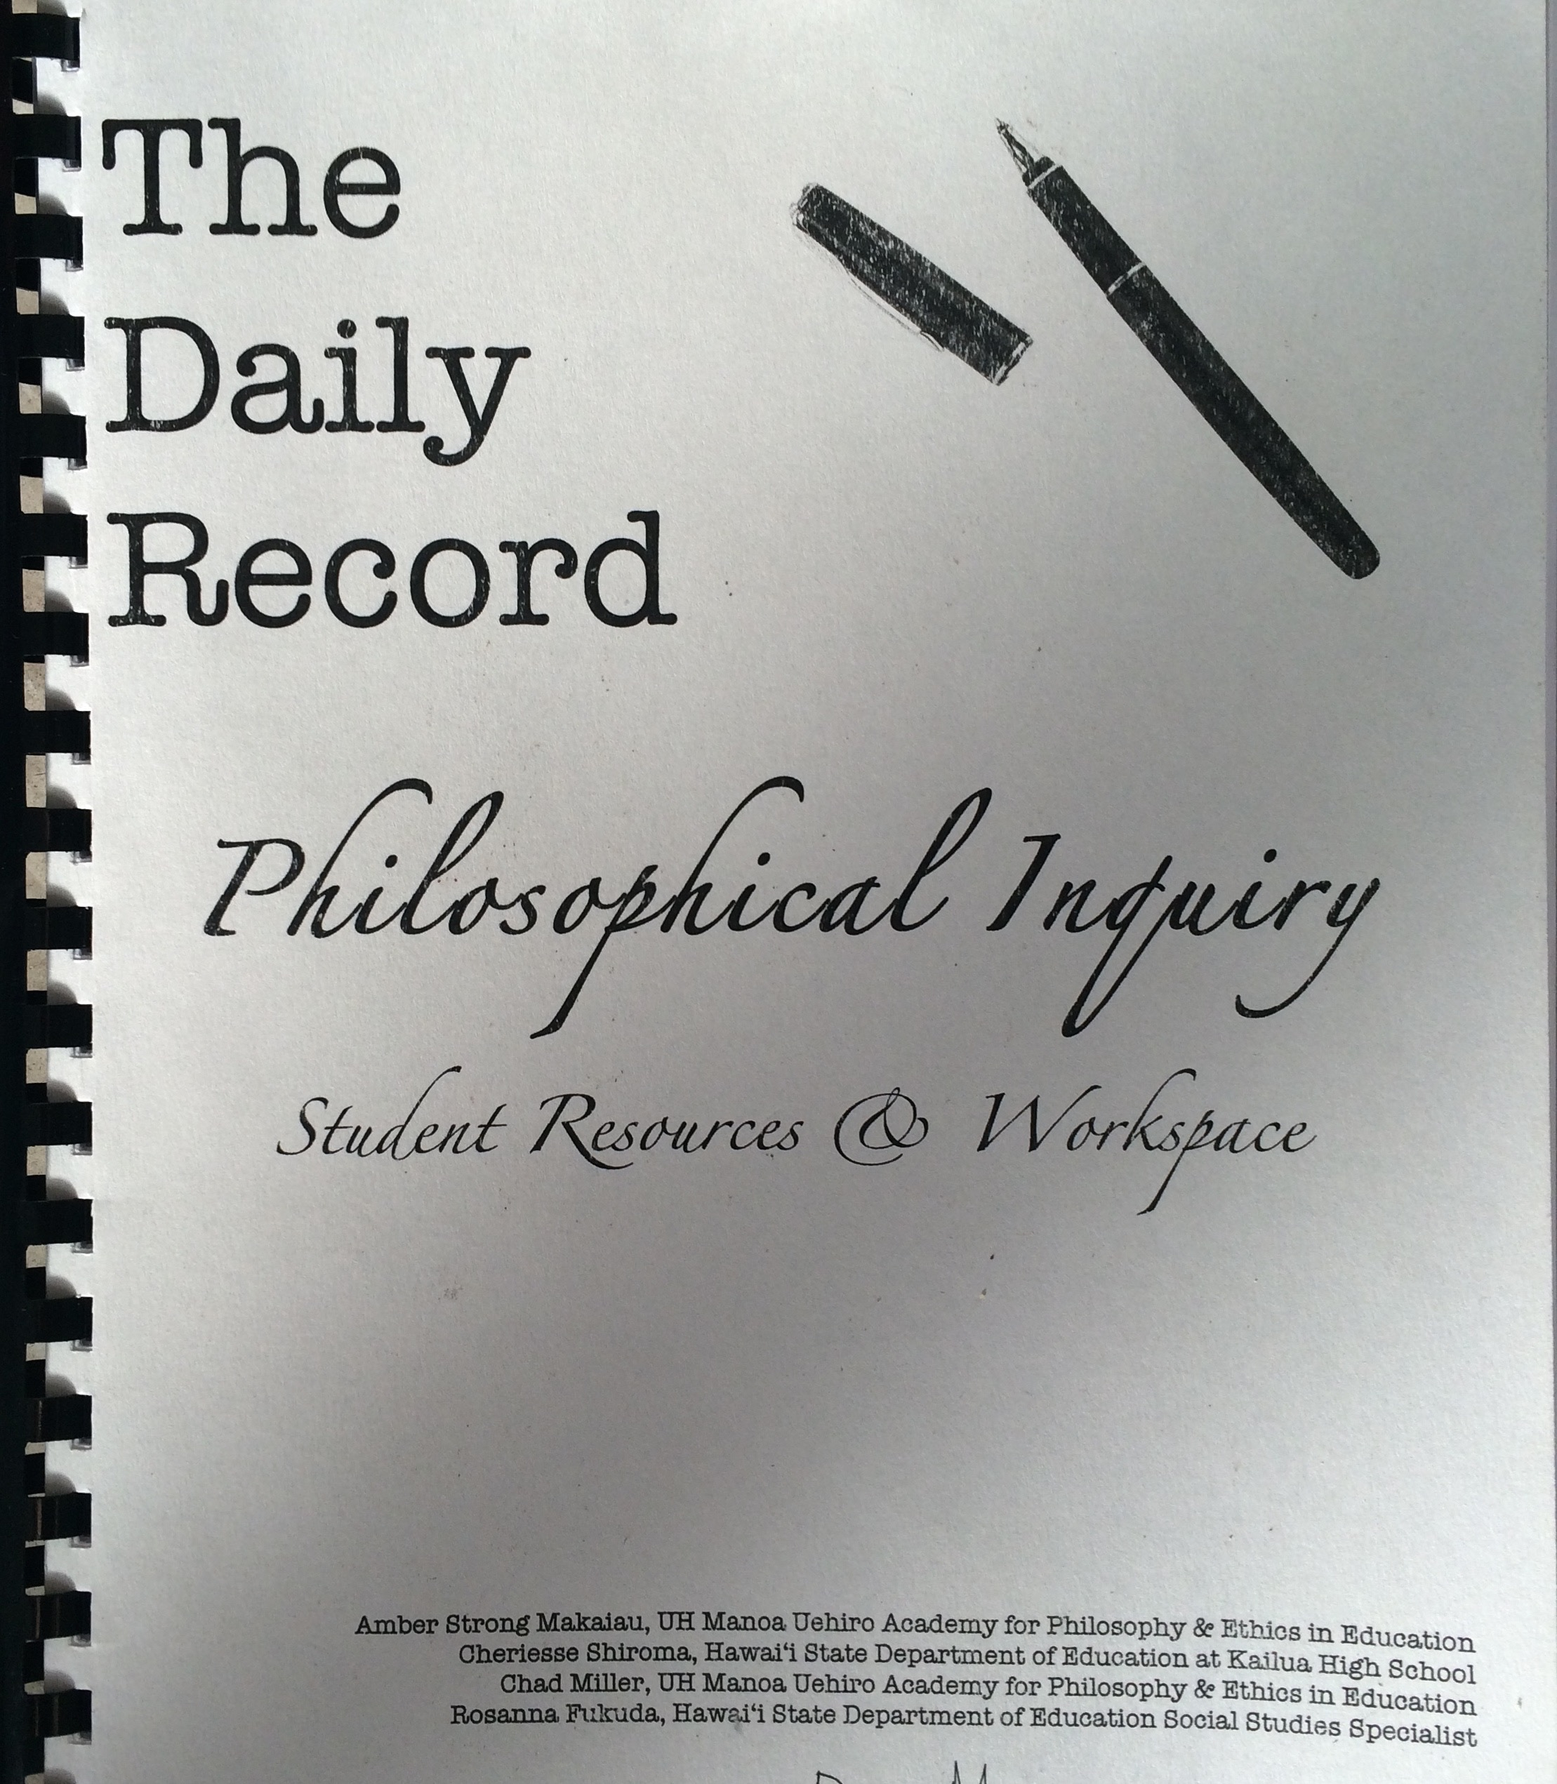
PHILOSOPHICAL INQUIRY
A brand new interdisciplinary social studies elective in the Hawaii State Department of Education aimed at developing students’ capacity to think as ethical members of their community.

Slide 26
P4C SENDAI

Slide 27
JUNIOR PHILOSOPHER IN RESIDENCE PROGRAM

Slide 28
PRE-SERVICE TEACHER PREPARATION

Slide 29
CREATING COMMUNITIES FOR ETHICAL RESEARCH

Slide 30
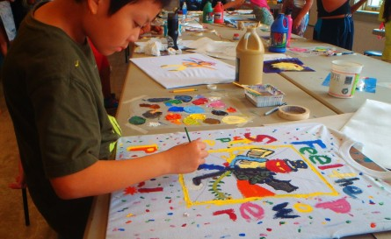
COMMUNITY PARTNERSHIPS
Honolulu Museum of Art Children’s Programs and Talk Series
PALS and PLACES Camp
Teaching Tolerance a Project of the Southern Poverty Law Center
Kettering Foundation
Weekend p4cHI Children’s Classes

Slide 31
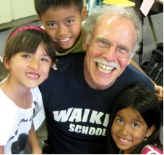
What is philosophy for children Hawaii?

Slide 32
QUESTIONS?

